Slide 1


Mehr chand polytechnic college,
jalandhar
Topic: DiGi park
Presented by :
Sanchit Bajaj
Sahil
Sarbjit singh

Slide 2
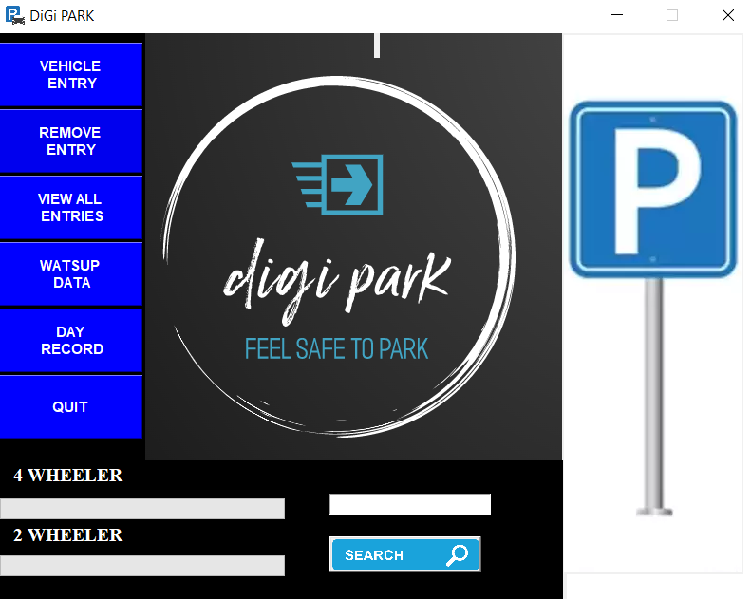
ABOUT OUR PROJECT
Parking management system is designed for managing the records of the incoming and outgoing vehicles in a parking area.
This system will reduce wastage of time and energy by helping workers of parking area by maintaining record of vacant slots and generating bill digitally.

Slide 3
TECHNOLOGY USED
Presentation Layer:
Tkinter
Business Layer:
PYTHON 3.10.6
Database Layer:
MYSQL 8.0
Tkinter is the inbuilt python module that is used to create GUI applications. It is one of the most commonly used modules for creating GUI applications in Python as it is simple and easy to work with. You don’t need to worry about the installation of the Tkinter module separately as it comes with Python already. It gives an object-oriented interface to the Tk GUI toolkit.

Slide 4

PYTHON 3.10.6 :
Python is an interpreted, object-oriented, high-level programming language. Its high-level built in data structures, combined with dynamic typing, make it very attractive for Rapid Application Development
Python's simple, easy to learn syntax emphasizes readability and therefore reduces the cost of program maintenance. Python supports modules and packages, which encourages program modularity and code reuse.

Slide 5

PYTHON FEATURES :
1. High-level Language
2. Easy to Code
3. Easy to Understand
4. Free and Open-Source
5. Interpreted
6. Portable
7. Object-Oriented and Procedure-Oriented
8. Support for GUI

Slide 6

MY SQL 8.0 :
• MySQL is a relational database management system.
• MySQL is open-source.
• MySQL is free.
• MySQL is ideal for both small and large applications.
• MySQL is very fast, reliable, scalable, and easy to use.
• MySQL is cross-platform.
• MySQL was first released in 1995.

Slide 7

PROJECT FEATURES
LOGIN
ADD VEHICLE ENTRY
SEND E-SLIP ON WHATSAPP
GRAPHICAL REPRSENTATION OF SLOTS
VIEW PARKED VEHICLES
VIEW LEFT PARKING SPACE
VIEW THE RECORD OF PARTICULAR DAY
GENERATE BILL
STORES THE FARE AND MOBILE NUMBER

Slide 8
DATA FLOW DIAGRAM
ADMIN
VEHICLE ENTRY
REMOVE ENTRY
BILL
E-SLIP
DATABASE

Slide 9
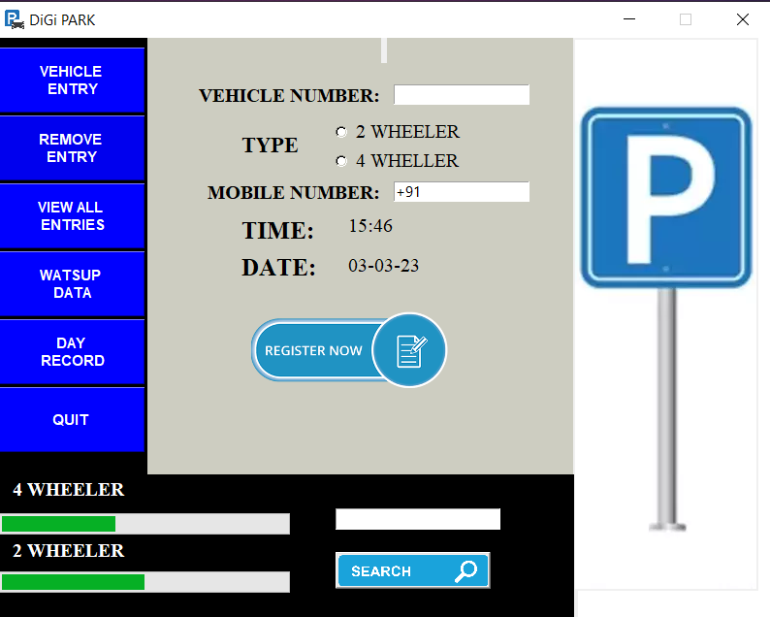
PROJECT WORK
VEHICLE ENTRY

Slide 10
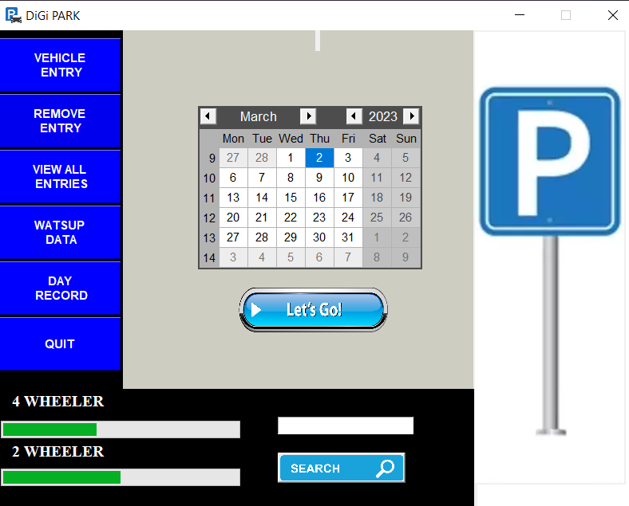
DAY RECORD

Slide 11
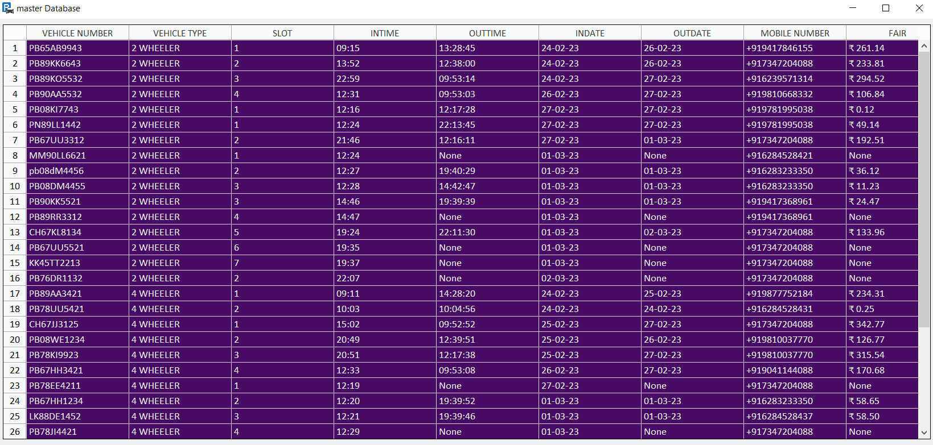
ALL ENTRIES

Slide 12
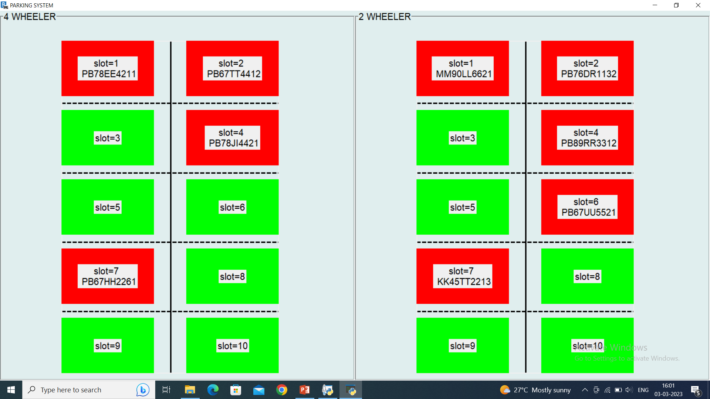
REPRESENTATION OF SLOTS

Slide 13

FUTURE WORK
we will ugrade this system with a number plate scanner. So that user does’nt have to enter number himself.
We will connect sensors and use iot in this project to make it more usefull.

Slide 14


